Slide 1
SARAH DANKWA FULL STACK PROJECT

Slide 2
Tools
Trello – Users stories and planning of tasks
Lucid Chart – ERD diagrams
Office 365 – UML diagrams & Risk assessment
Miro – MoSCoW template
Project management
Version control
GitHub – Main – Dev – Feature model
Java SpringBoot – Backend framework ran in Eclipse IDE
PostMan– API client to test controller methods
H2 – Non-persistent database for testing
Junit – Unit testing of class methods
Mockito – Integration testing across classes
BACK END + TESTING
Front end + connection
HTML – Front end/UI framework
CSS– Design framework for front end
JavaScript – Document object model to dynamically interact with html document for functionality.
Fetch API – connect with database in the back end.

Slide 3
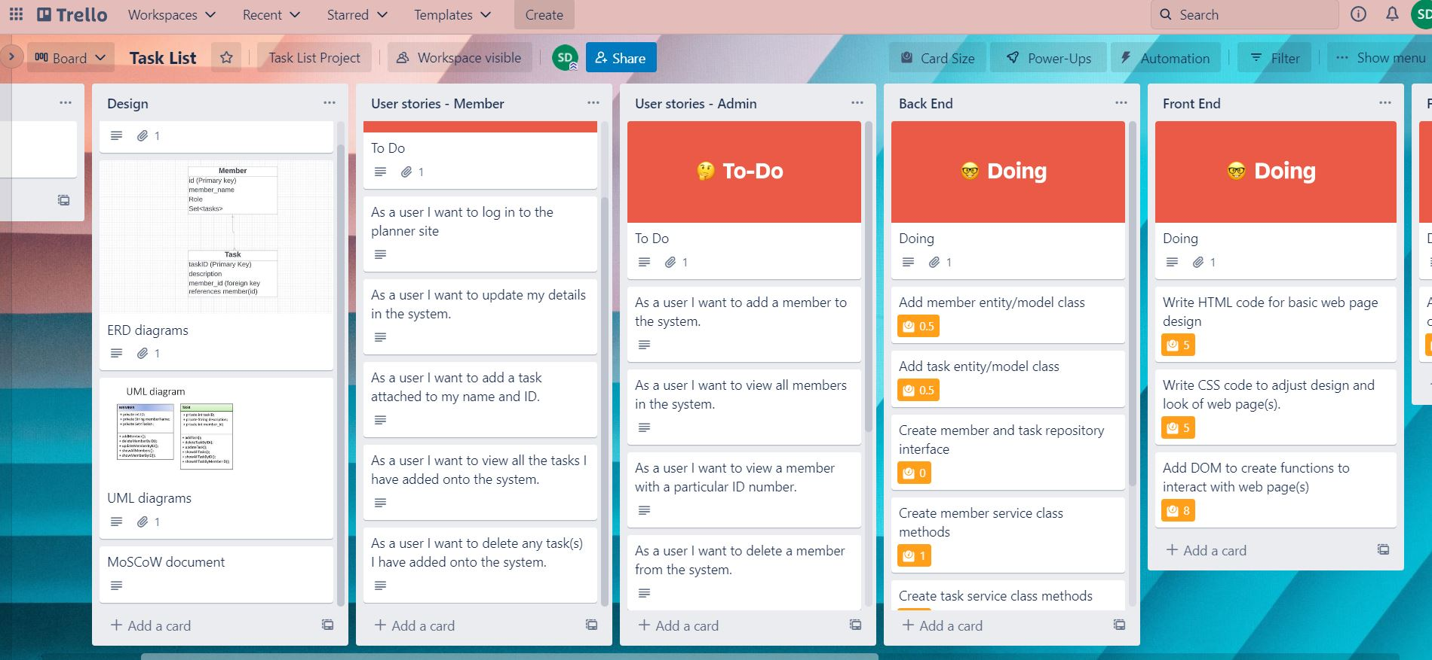
Project MANAGEMENT
I started with a project management to outline the project and initial planning.
My initial idea was a member task planner with different admin and member CRUD functionality.
Different user stories for admin and members
https://trello.com/b/r3Qry3wT/task-list
Tasks in the “Doing” section each have a story point based on their level of complexity.
They are added to the “Testing” section when done.

Slide 4
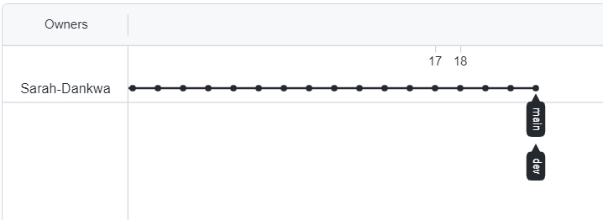
VERSION CONTROL
Begin with empty repo in Github.com
Set Java application in Eclipse as local git repository and link to the remote repo.
Main branch => dev branch => different feature branches based on functionality.
Merge feature branches to dev and push to remote.
FINALLY merge dev to main and push to main.
Deleted feature branches before screen-shotting!!

Slide 5
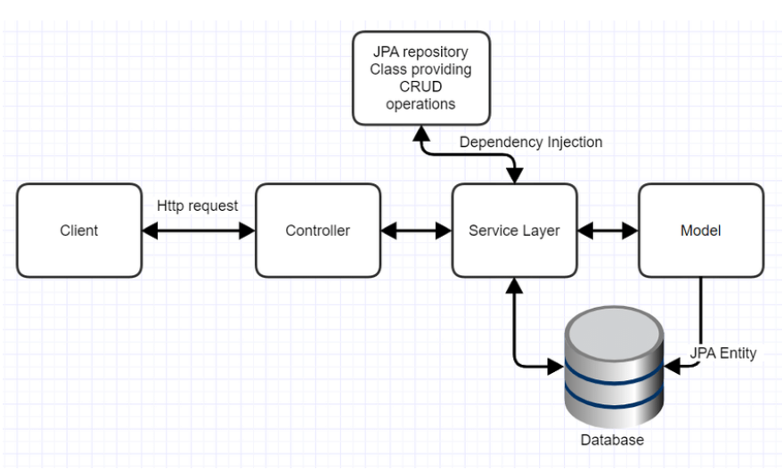
BACK END + TESTING
SpringBoot is the perfect way to create fast-running applications.
Connection to database is the via service and model layers and to the front-end via the controller layer.

Slide 6
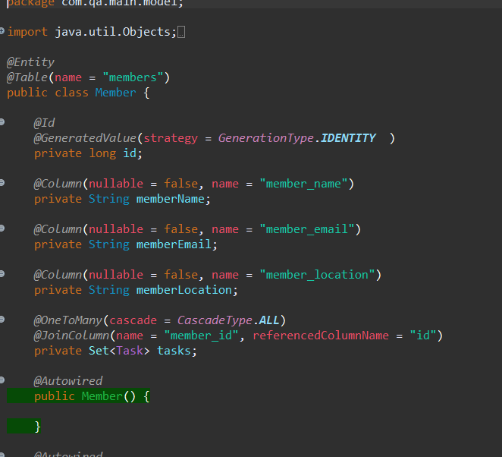
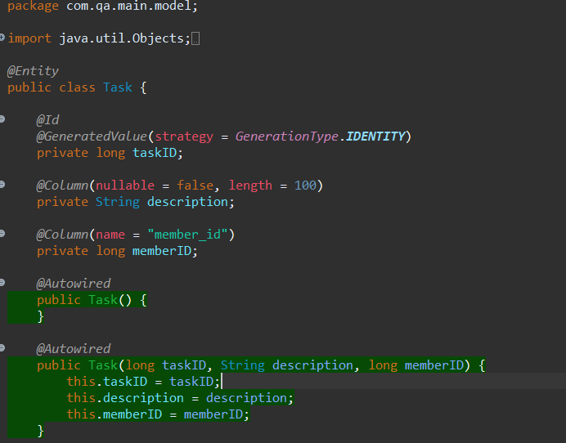
To fulfil my initial idea the member entity would have a “role” column attached which would be a normal member or admin. Admin would have access to different functions.
I ended up adjusting this idea and ended up with members and tasks only.
A member could have 0 or more tasks and each task would be associated with a member.

Slide 7
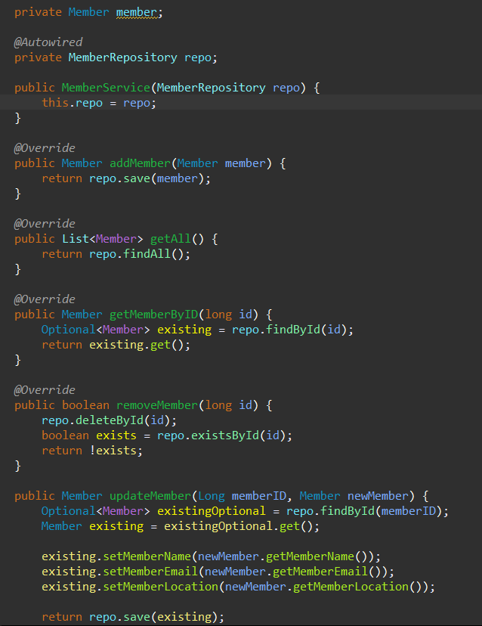
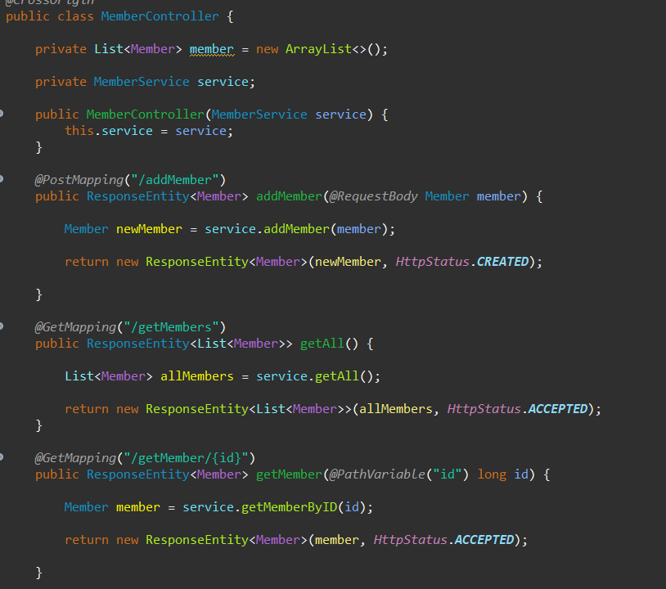
SERVICE LAYER
CONTROLLER LAYER
servissociated with a member.
Acts as a go between the application and entities. For example, it provides the logic needed to “get all members” if required.
Responsible for processing API requests and rendering the view as an HTTP Response. I.e., when get all members is invoked the response renders as accepted!

Slide 8
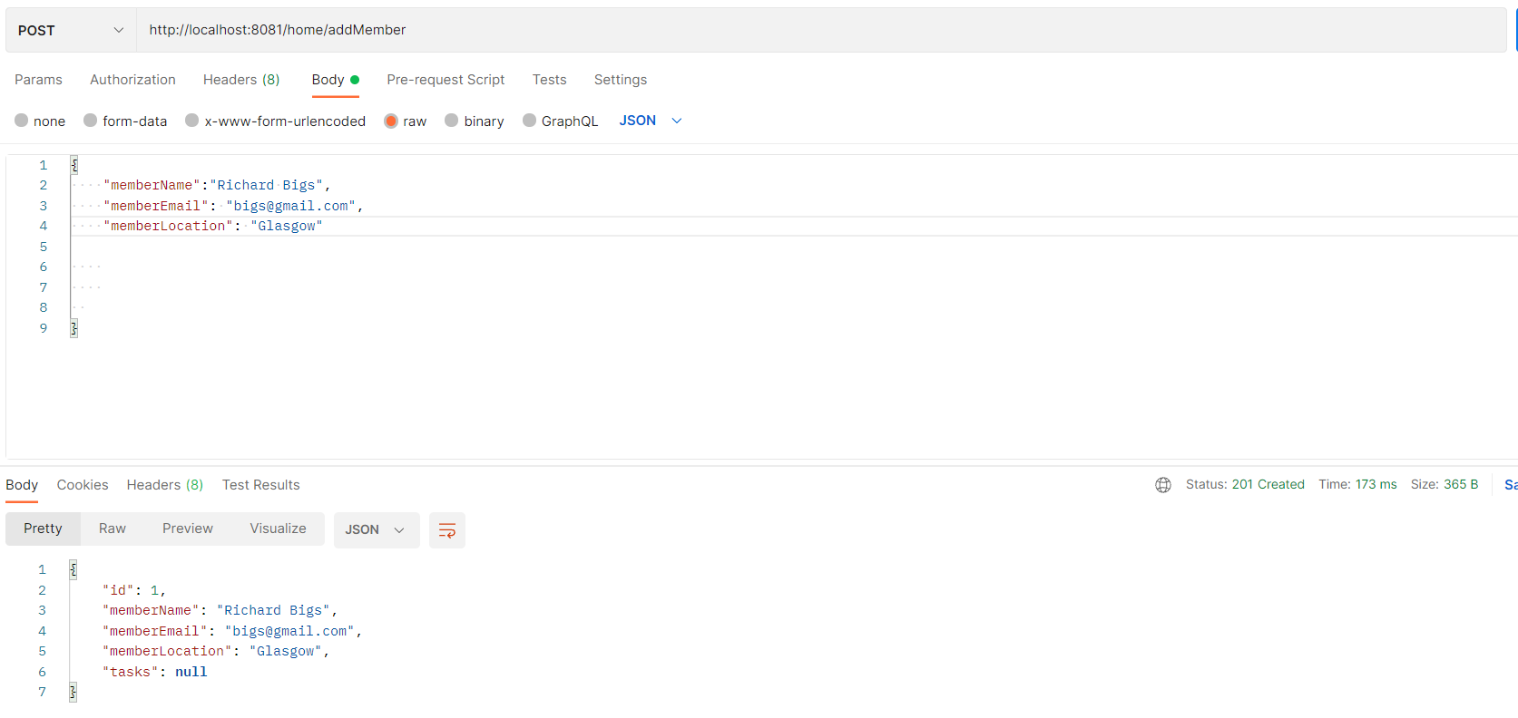
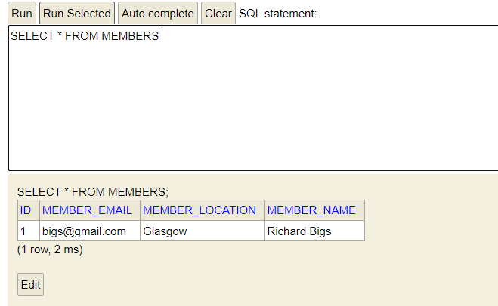
Checking controller API requests.
For example, “POST” is for creation of objects.
HTTP response
Data shows in non-persistent database

Slide 9
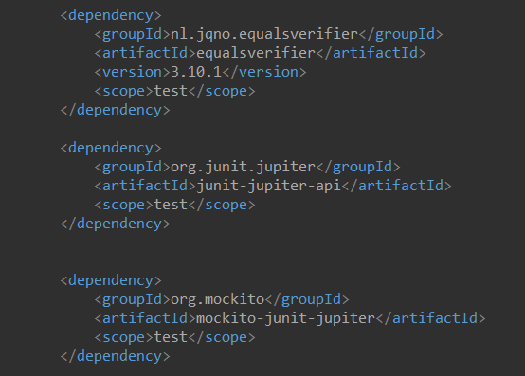
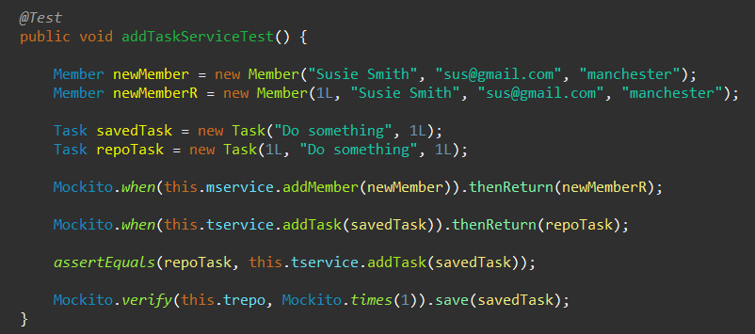
Added 3 dependencies to POM to enable testing of application
Example Task Service test for adding tasks to system.
Create a member first for task to be assigned to. (Tests can be performed in any order so there needs to be a member).
Mockito will check that when the member is created, it is added to the system (returned) in the correct format(i.e., with the generated id number).
Create a task with the member id.
Check task is saved and that this happens only once.

Slide 10
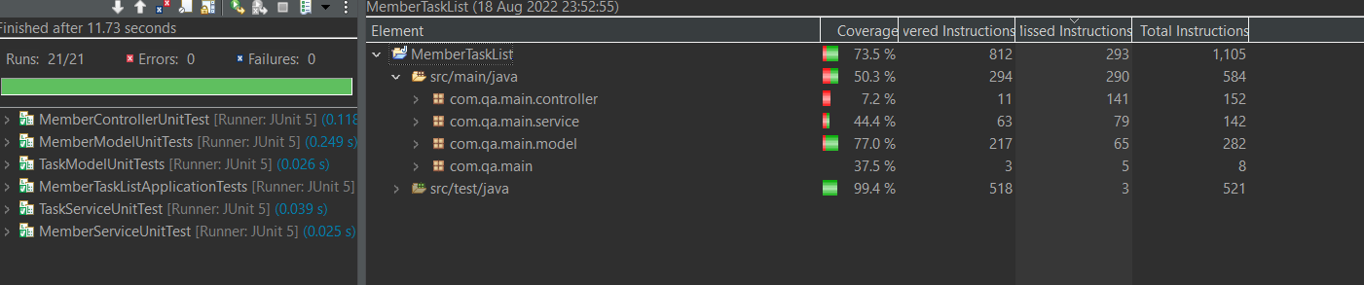
All tests passed with 73.5% of the applications methods being tested.

Slide 11
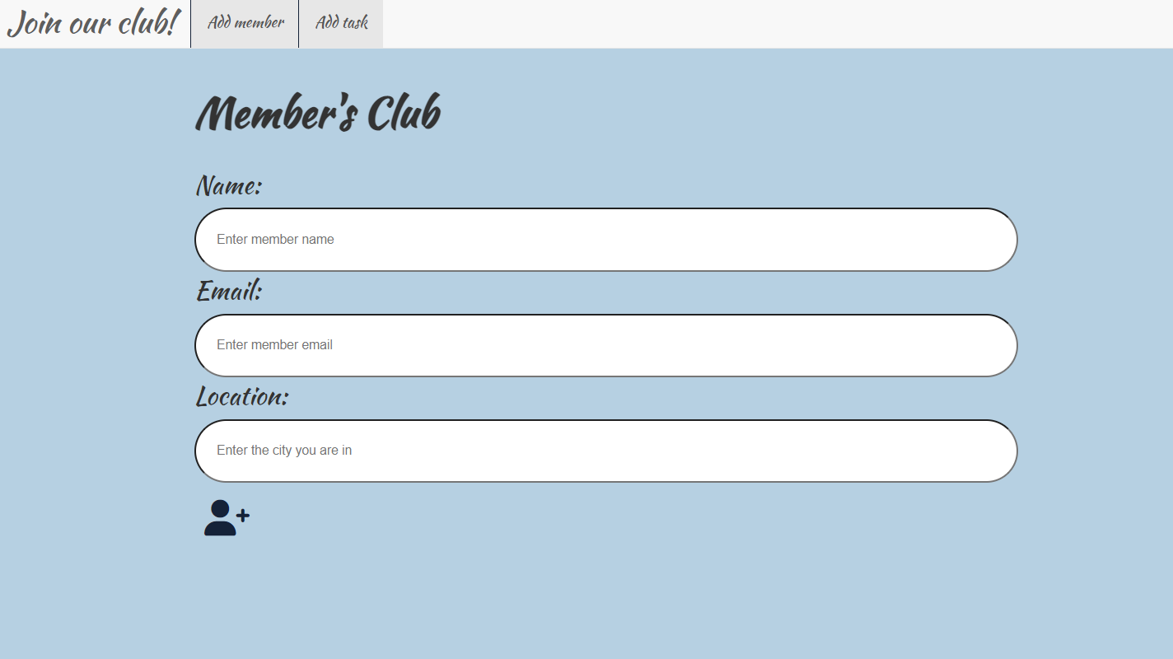
FRONT END + CONNECTION
Members can add their details to the system and……

Slide 12
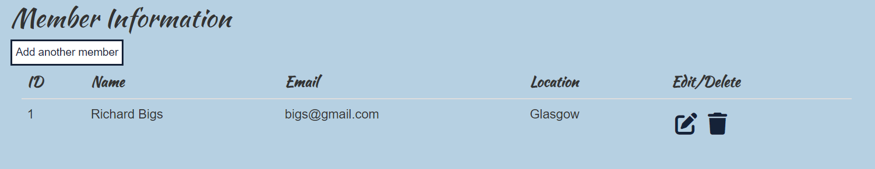
FRONT END + CONNECTION
…. member details are displayed in the table with the ability to see all members, edit or delete a member or go back and add another member.

Slide 13
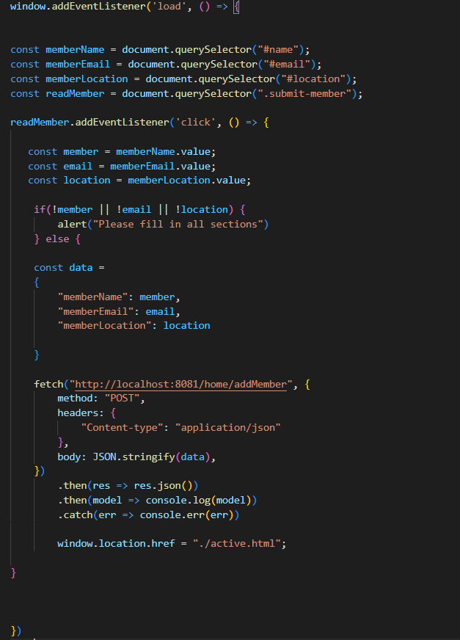
The Document Object Model DOM uses JavaScript logic to provide functionality to the page and incorporates the fetch API to communicate with the backend.
When the page is fully loaded….
….the document.querySelector method will call upon certain elements of the html (website).
When the add Member button is clicked….
….the data entered into each input section will be used to CREATE a new member in the database using the “POST” request.
The page will then automatically link to the second page.

Slide 14
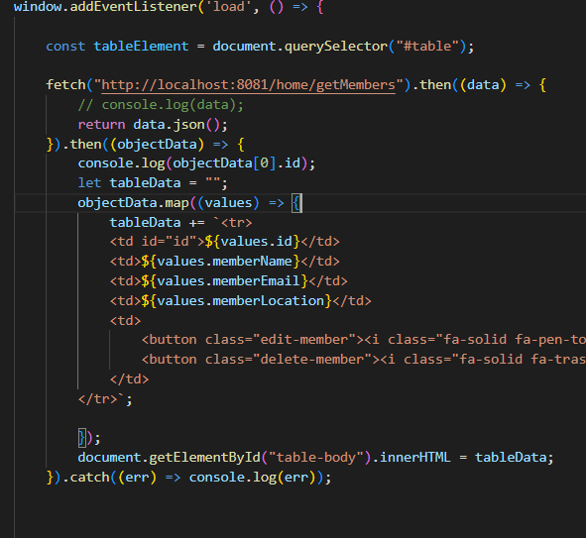
Whenever the page is loaded the table needs to display all the members in the database using the fetch api and “GET” mapping.
….the table needs to be created dynamically – each row and all information will be added so the table needs to be empty initially otherwise new member information will be displayed multiple times
Each row is added to which the values found in the data from the database.
The edit and delete buttons are also added to the table.
NB. For some reason the table page needs to be refreshed before the first member added shows!

Slide 15
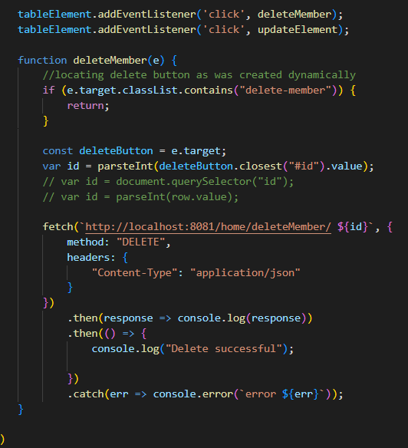
As the table is created dynamically and inside a function, I found it difficult to access the edit and delete button from outside the function.
If added to the main show all function it would only work for each new member added.
I found a way to target the class I needed using “e.target” however I was unable to access and extract the ID specifically to input into the delete and update functionality.
I could have used a “deleteButton.closest(“tr”).remove();” function which would have removed the row but not the data from the database meaning each time the page was reloaded the deleted member would still show.

Slide 16
SUMMARY
My initial plan for the frontend was to input a member and show the tasks all on the one page.
I found this challenging to append the member to the task and incorporate this into the fetch api requests.
I decided to complete the functionality for one entity(member) before adding the functionality and client- side tools for the second entity.
I believe if I was given the opportunity to do this project again, I would again begin with building the back-end component, but perhaps plan the front end more first.

Slide 17
THANK YOU
SDankwa@qa.com
https://github.com/Sarah-Dankwa

